Slide 1

Visual Tracking with
Online Multiple Instance Learning
Boris Babenko¹, Ming-Hsuan Yang², Serge Belongie¹
1. University of California, San Diego
2. University of California, Merced

Slide 2
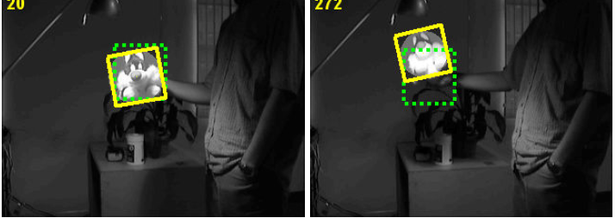
Tracking
Problem: track arbitrary object in video given location in first frame
Typical Tracking System:
  Appearance Model
    Color histograms, filter banks, subspaces, etc
  Motion/Dynamic Model
  Optimization/Search
    Greedy local search, particle filter, etc
[Ross et al. ‘07]

Slide 3
Tracking
Problem: track arbitrary object in video given location in first frame
Typical Tracking System:
  Appearance Model
    Color histograms, filter banks, subspaces, etc
  Motion/Dynamic Model
  Optimization/Search
    Greedy local search, particle filter, etc
[Ross et al. ‘07]

Slide 4
Tracking by Detection
Recent tracking work
  Focus on appearance model
  Borrow techniques from obj. detection
    Slide a discriminative classifier around image
  Adaptive appearance model
[Collins et al. ‘05, Grabner et al. ’06, Ross et al. ‘08]

Slide 5

Tracking by Detection
First frame is labeled

Slide 6
Tracking by Detection
First frame is labeled
Classifier
Online classifier (i.e. Online AdaBoost)

Slide 7
Tracking by Detection
Grab one positive patch, and some negative patch, and train/update the model.
positive
negative
Classifier

Slide 8

Tracking by Detection
Get next frame
positive
negative
Classifier

Slide 9

Tracking by Detection
Evaluate classifier in some search window
positive
negative
Classifier
Classifier

Slide 10
Tracking by Detection
Evaluate classifier in some search window
X
positive
negative
old location
Classifier
Classifier

Slide 11
Tracking by Detection
Find max response
X
X
positive
negative
old location
new location
Classifier
Classifier

Slide 12
Tracking by Detection
Repeat…
positive
negative
positive
negative
Classifier
Classifier

Slide 13
Problems with Adaptive Appearance Models
What if classifier is a bit off?
  Tracker starts to drift
How to choose training examples?

Slide 14















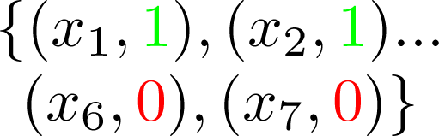

How to Get Training Examples
Classifier
Classifier
MIL
Classifier

Slide 15
Multiple Instance Learning (MIL)
Ambiguity in training data
Instead of instance/label pairs, get bag of instances/label pairs
Bag is positive if one or more of it’s members is positive
[Keeler ‘90, Dietterich et al. ‘97]

Slide 16
Object Detection
Problem:
  Labeling with rectangles is inherently ambiguous
  Labeling is sloppy
[Viola et al. ‘05]

Slide 17
MIL for Object Detection
Solution:
  Take all of these patches, put into positive bag
  At least one patch in bag is “correct”
[Viola et al. ‘05]

Slide 18







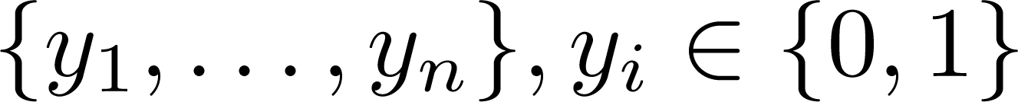
Multiple Instance Learning (MIL)
Supervised Learning Training Input
MIL Training Input

Slide 19

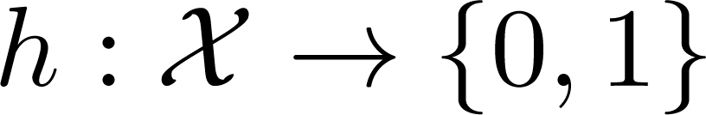
Multiple Instance Learning (MIL)
Positive bag contains at least one positive instance
Goal: learning instance classifier
Classifier is same format as standard learning

Slide 20
How to Get Training Examples
Classifier
Classifier
MIL
Classifier

Slide 21
How to Get Training Examples
Classifier
Classifier
MIL
Classifier

Slide 22
Online MILBoost
Need an online MIL algorithm
Combine ideas from MILBoost and Online Boosting
[Oza et al. ‘01, Viola et al. ’05, Grabner et al. ‘06]

Slide 23
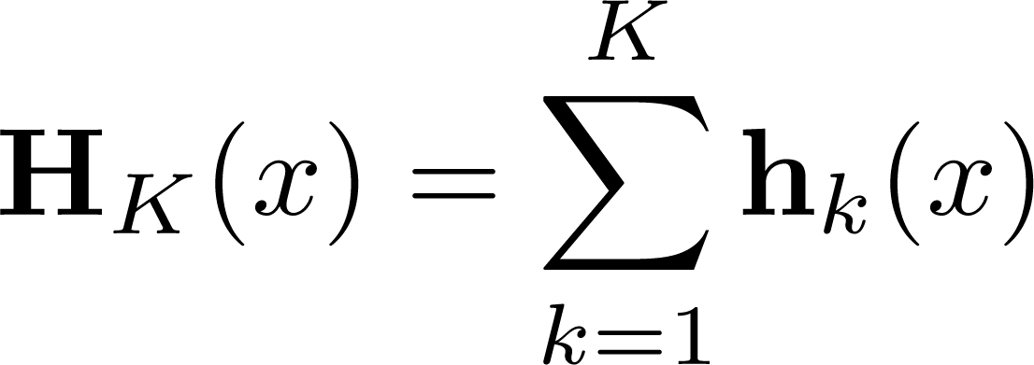

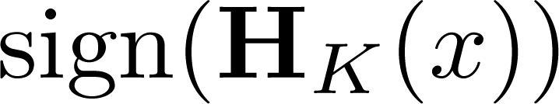
Boosting
Train classifier of the form:
where is a weak classifier
Can make binary predictions using
[Freund et al. ‘97]

Slide 24
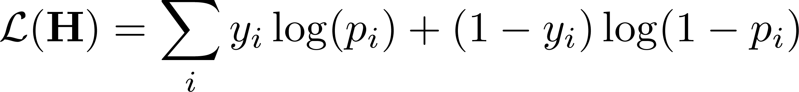
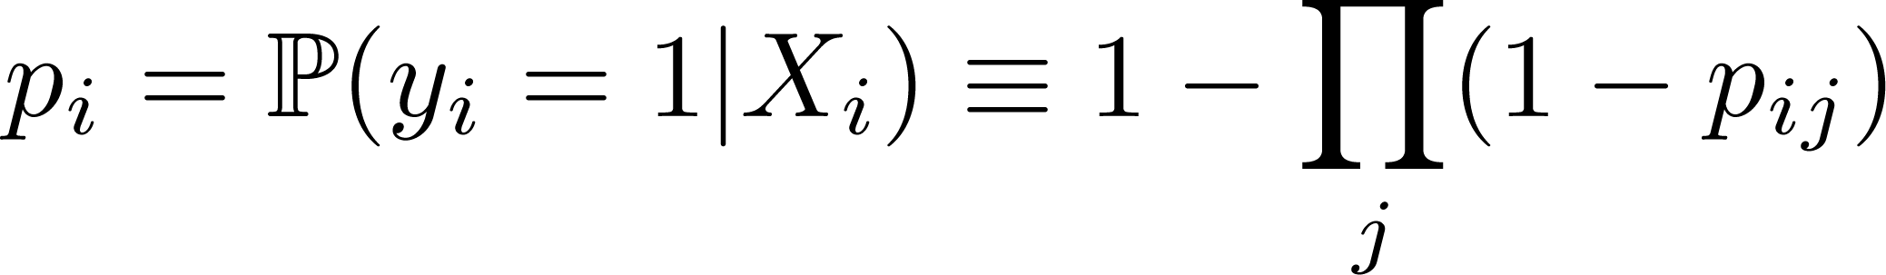
MILBoost
Objective to maximize: Log likelihood of bags:
where
(as in LogitBoost)
(Noisy-OR)
[Viola et al. ’05, Friedman et al. ‘00]

Slide 25
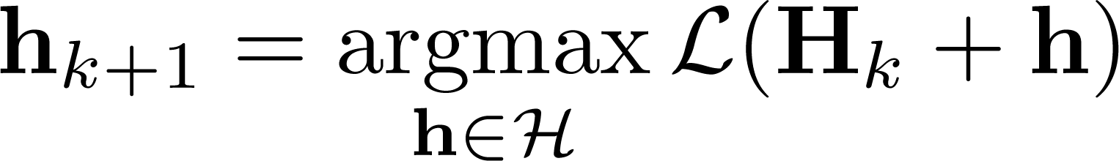
MILBoost
Train weak classifier in a greedy fashion
For batch MILBoost can optimize using functional gradient descent.
We need an online version…

Slide 26

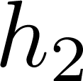
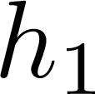
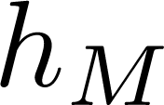
Online MILBoost
At all times, keep a pool of weak classifier candidates
[Grabner et al. ‘06]

Slide 27


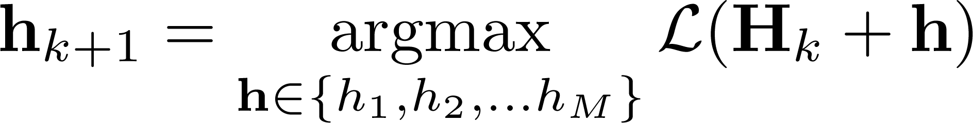

Updating Online MILBoost
At time t get more training data
  Update all candidate classifiers
  Pick best K in a greedy fashion

Slide 28









Online MILBoost
Frame t
Frame t+1
Get data (bags)
Update all classifiers
in pool
Greedily add best K to
strong classifier

Slide 29
MILTrack
MILTrack =
  Online MILBoost +
  Stumps for weak classifiers +
  Randomized Haar features +
  Simple motion model + greedy local search
[Dollar et al. ‘07]

Slide 30
Experiments
Compare MILTrack to:
  OAB1 = Online AdaBoost w/ 1 pos. per frame
  OAB5 = Online AdaBoost w/ 45 pos. per frame
  SemiBoost = Online Semi-supervised Boosting
  FragTrack = Static appearance model
All params were FIXED
8 videos, labeled every 5 frames by hand (available on the web)
[Grabner ‘06, Adam ‘06, Grabner ’08]

Slide 31
OAB1
OAB5
MILTrack
Classifier
Classifier
MIL
Classifier

Slide 32

Videos…

Slide 33
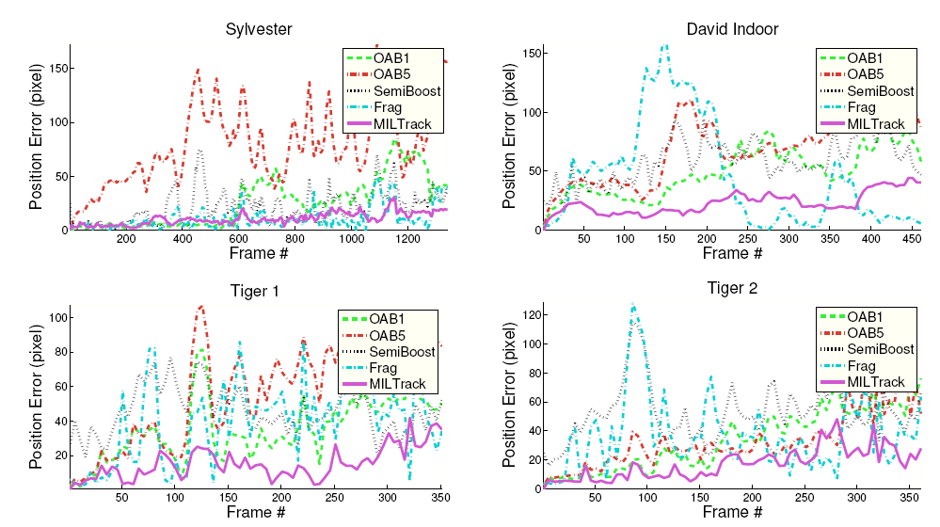
Results

Slide 34
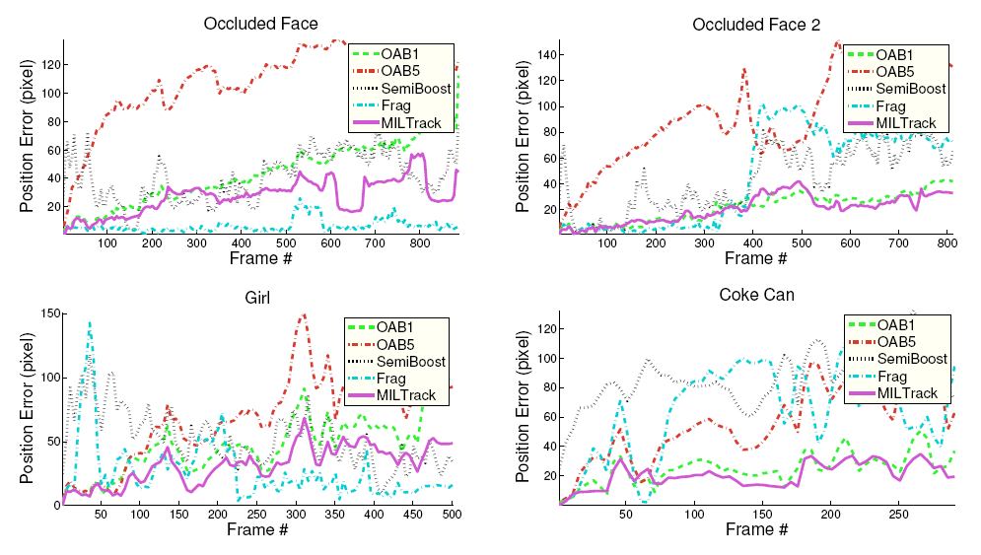
Results

Slide 35
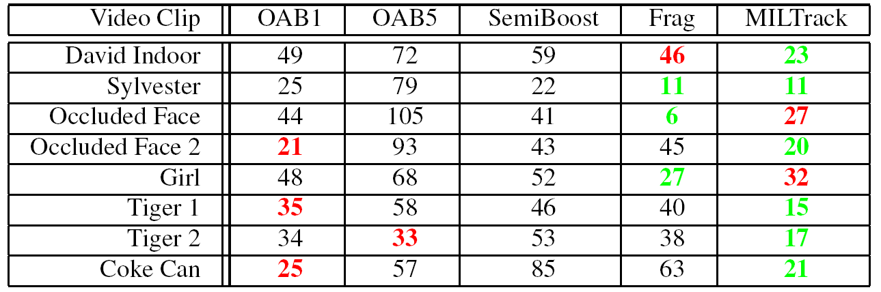
Results
Best
Second Best
Ground truth: labeled every 5 frames

Slide 36
Conclusions
Proposed Online MILBoost algorithm
Using MIL to train an appearance model results in more robust tracking
Data and code on my website

Slide 37
Thanks!
Special thanks to:
  Kristin Branson, Piotr Dollár, David Ross
Supported by:
  NSF CAREER Grant #0448615, NSF IGERT Grant DGE-0333451, and ONR MURI Grant #N00014-08-1-0638, Honda Research Institute USA.

Slide 38

Updating candidate classifiers
Subtlety: need instance labels to update candidate weak classifiers…
Set
Not optimal; weak classifiers try to minimize instance error
The weak classifiers are chosen to minimize bag error

Slide 39
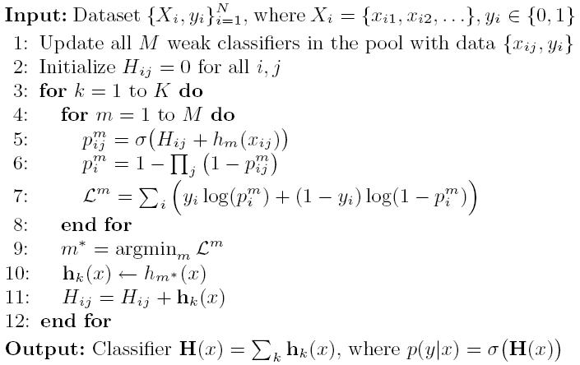
Online MILBoost

Slide 40




Illustration
Frame 1
(Labeled)
Clf Initialize
Frame 2
Clf Update
Ftr Pool:
Ftr Pool:
Frame 3
1 2 3
Apply Clf
1 2 3
Initial Positive
Example
{ }
Extracted Positive
Example
{ }
OAB
OAB Clf =
OAB Clf =
Initial Positive
Example
Extracted Positive
Examples (a Bag)
MIL
{ }
{ }
MIL Clf =
{ }
MIL Clf =

Slide 41
Future Work
Interested in:
  Tracking with a stereo rig / rough depth estimate
  Tracking with very high frame rate
  Tracking with transfer learning (i.e. when you have a very good prior model)

